Slide 1

How to read Entromy output
This deck includes the purpose and methodology of key slides included in Entromy’s Organizational Health Baseline assessment

Slide 2
Reminder: Objective of Organizational Health Survey
Touches the following areas:
Company direction & brand
Performance & accountability
Operational effectiveness
Leadership
Capabilities
Culture
Org structure
Engagement
Communication
Collaboration
Organizational Health Diagnostic instantly identifies:
Key strengths, weaknesses, and opportunities to accelerate growth
Key Influencers and collaboration patterns
Top Ideas on risks and impact opportunities

Slide 3
Entromy’s framework for assessing Organizational Health
Comprehensive coverage of topics that drive high-performance
Company strategy
Performance & accountability
Operational excellence
Leadership
Capabilities
•
Clearly understood
•
Clear operational goals
•
Effective customer support
Executive
Leaders
•
On
-
boards new hires
•
Strong industry image
•
Delivers on key priorities
•
Drives
continuous
•
Strong senior leaders
effectively
•
Makes strategic tradeoff
•
Performance
contracts
improvement
•
Highly functioning
senior team
•
Recruits and hires right
choices
•
Incentivizes the right
•
Leverages
technology
•
Epitomize
the org’s values
talent
•
Drives innovation
•
behaviors
•
Efficient
& clear processes
Department Leaders
•
Develops employee
•
Confidence in success
•
Leaders model
accountability
•
Data
-
driven
decisions
•
Focus
efforts on top priorities
capabilities
•
Effective customer
•
Provides real time feedback
•
Leverages
external expertise
•
Balance
fire
-
drills and
•
Right people, right roles
support
•
Rewards
top performers
•
Functions
to strengthen
progress
Takes action to address low
•
Drive
collaboration
performance
•
Manage
conflicts
•
Leadership strengths
•
Leadership areas for growth
Culture
Organizational design
Engagement
Communication
Collaboration
•
Safe, supportive and
•
Clear reporting lines
•
Meaningful
work
•
Communicates decisions
•
Provides
direction on
•
inclusive
•
Cross
-
BU partnership
•
Able
to be productive
•
Shares best practices
priorities
Entrepreneurial culture
•
Right authority levels
•
Communicates ideas openly
•
Helps with
complex
•
Timely decision making
•
Personal career growth
•
Openness to ideas from
•
problems
•
Transparent
and
teams
•
Unreachable enabler
collaborative
•
Discuss new ideas
•
Culture strengths
•
Personal support
•
Cultural change for the
•
Career advice
future
Inspires people

Slide 4
3 Types of questions in Entromy’s survey
The Entromy Organizational Health baseline includes 3 types of questions:
Fixed answer questions:
Survey responders choose a fixed answer on a 6-point scale from Strongly Disagree to Strongly Agree
Majority (~80%) of the questions in the survey are fixed answer question
The scores in the document represent % of survey respondents who “Strongly Agree” or “Agree” to a statement or question
Open-ended questions:
Survey responders are asked to enter in their comments/response to statements or questions
Through AI and Natural Language Processing (NLP) embedded in the Entromy platform and our technology, we provide a quantitative perspective to open ended comments.
Comments are scored based on cumulative actions users take as comments are added into the system
List-select questions:
Survey responders are asked to nominate others in the organization that display leadership attributes. These questions fall into Entromy’s Organizational Network Analysis (ONA) and collaboration section
Entromy’s default question set asks responders to nominate others who display strengths in topics like Strategy, Problem Solving, Innovation, Energy, Personal Support, and Career Advice
Each nomination category is linked to a specific question in the survey. Innovation, for example, is linked to the question “Which individual(s) do you communicate with about new, innovative product & service ideas or new ways of doing business?”

Slide 5
How the results/output is organized in this report
Fixed answer questions:
Scores for fixed answer questions indicate % of survey respondents who “Strongly Agree” or “Agree” to a statement
Scores for fixed-answer questions are show in three ways
  Overall score: This is a composite score of all fixed answer questions
  Category score: Questions or statements on related topics are bucketed in categories like “Company Direction”, “Engagement”, etc.
  Individual statement/questions scores: Scores for individual questions are also reported; for formatting purposes we distill the full statements/questions into key terms (vs displaying the full question)
Any statement or question scoring below 50 is colored in red moving from light red (40s) to dark red (near score of 0)
Fixed answers are compared to other organizations in Entromy’s benchmarks.
In order to add helpful context to the survey results, the survey data is compared against Entromy benchmarks. Entromy’s dataset includes 400 mid-sized PE backed companies. Survey data is compared against top-quartile performers.
Open-ended questions: In this report, user generated comments appear in quotations (e.g., “Implement CRM system to move us from ad hoc spreadsheets)
The first time a new comment is created, it is assigned +5 points. If a survey participant accepts the comment as their own, +5 points are assigned to the comment
Responders are also given the opportunity to rank comments by other users (User strongly agrees +3, Agrees +2, Strongly disagrees -3pts)
Scores next to statements in quotations represent the cumulative score generated as users up-vote or down-vote a comment
List-select questions: Any names noted in the output are a result of peer nominations.
Scores represent the number of times an individual has been nominated.
Users have the option to choose any colleague in the org via a drop-down; they also have option to type in nominations

Slide 6
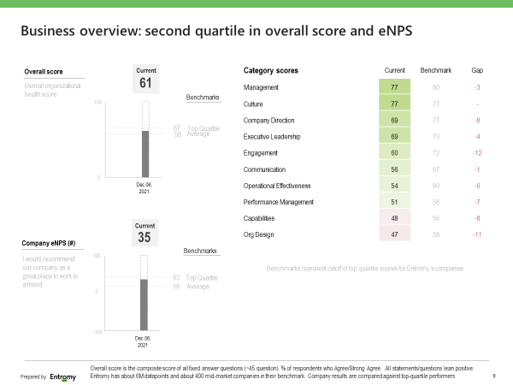
UNDERSTANDING YOUR ENTROMY REPORT
Business Overview
Purpose: To show how your company overall and category scores compare to top quartile Entromy companies
Overall score is the composite score of all fixed answer questions (~45 question). % of respondents who Agree/Strong Agree. All statements/questions lean positive. A score of 50 or above will display as varying shades of green while scores below 50 will show as varying shades of red.
Company eNPS: Employee Net Promoter Score is on a scoring scale from -100 to 100, and assesses the question: "On a scale of 0-10, how likely are you to recommend (company) as a great place to work?"
NPS is a very common measure for both customer and employee experience. The eNPS calculation you'll see in Entromy's reporting is the % of promoters minus the % of detractors, following the below definitions:
      Promoters: People who responded 9 or 10
      Passives: People who responded 7 or 8
      Detractors: People who responded 0 - 6
Entromy Benchmarks: Entromy has about 6M datapoints and about 400 mid-market companies in their benchmark. Company results are compared against top-quartile performers

Slide 7
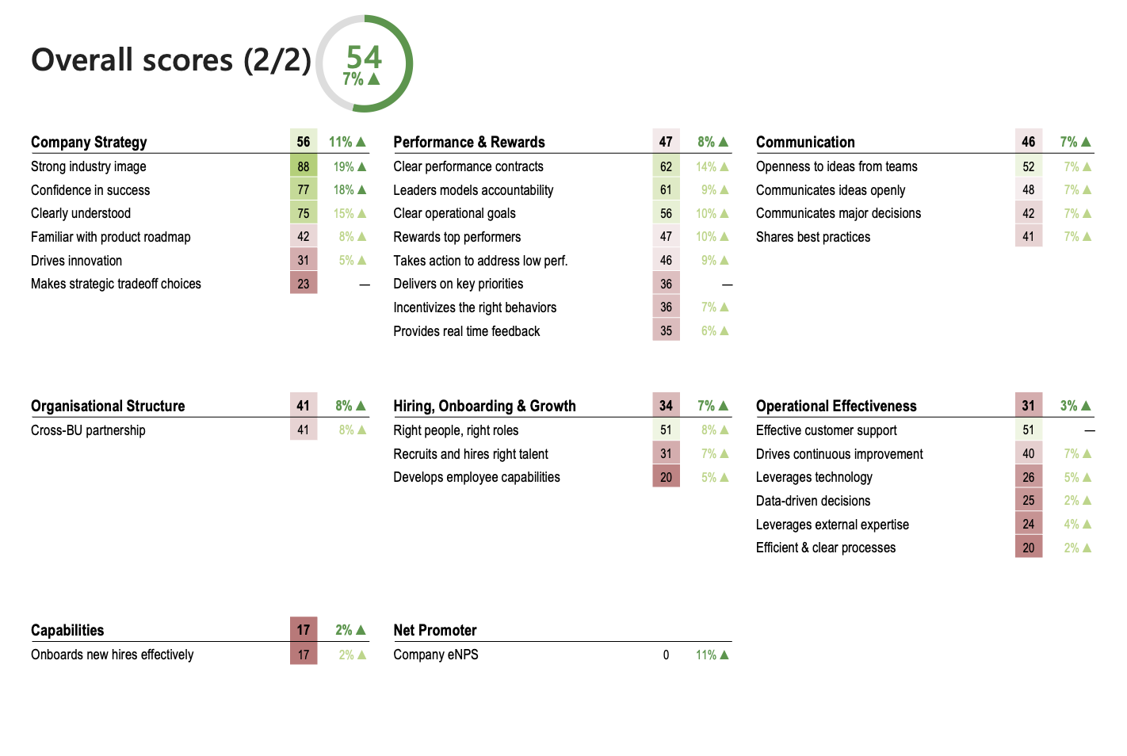
UNDERSTANDING YOUR ENTROMY REPORT
Overall Scores
The Overall Scores slide(s) will show scores for all fixed answer questions (6-point scale Likert questions) and the Employee Net Promoter Score. A score of 50 or above will display as varying shades of green while scores below 50 will show as varying shades of red.
Each keyword on this slide is associated with one specific question. For example, “Safe, supportive & inclusive” under the Culture category is associated with the statement, “My work environment is safe, supportive, and inclusive.” Category and overall score change calculated as weighted average difference between periods for all current questions that also have prior period data, % of responses that Agree / Strongly Agree.

Slide 8
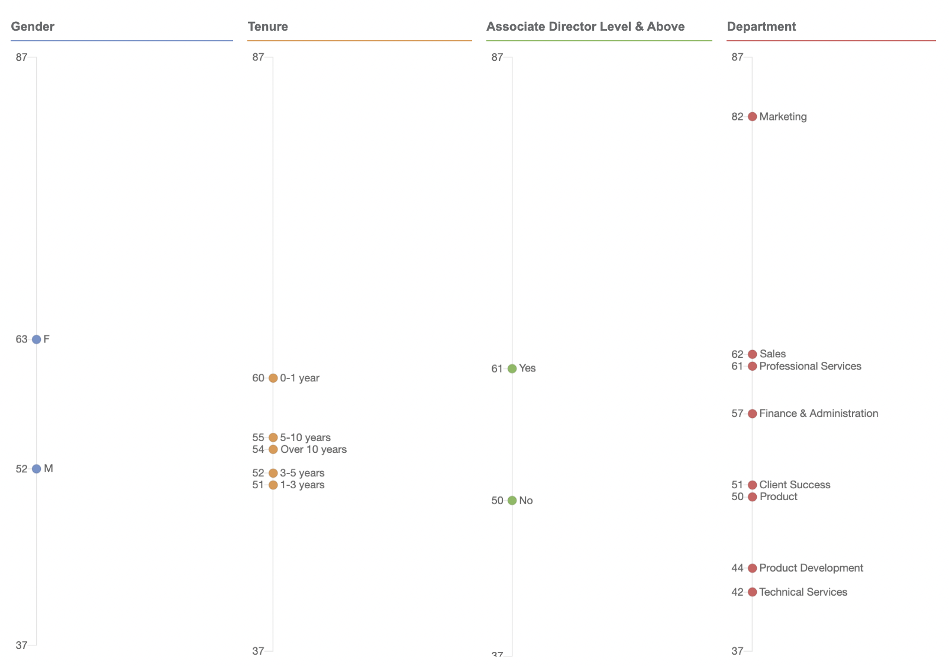
UNDERSTANDING YOUR ENTROMY REPORT
Scores by Dimension
Overall scores by dimension shows overall average scores for groups i.e., by tenure, location, or department.
The number of survey participants and people per group will determine the number of dimensions shown on these graphs. To maintain anonymity, Entromy only reports on groups of 3-5 people (depending on sample size), so groups that do not meet this threshold will not show.

Slide 9
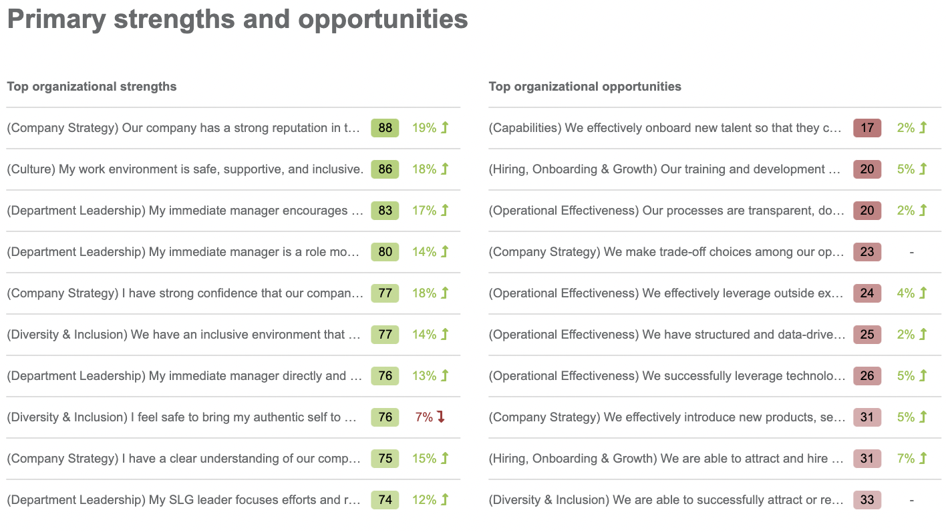
UNDERSTANDING YOUR ENTROMY REPORT
Primary Strengths & Opportunities
Primary Strengths & Opportunities shows the top ten questions with the highest scores and the bottom ten questions with the lowest scores for a particular report and group of participants.
Use this slide to target areas that you want to maintain, strengthen, and shift your focus to as a team. For example, Operational Effectiveness and Hiring, Onboarding & Growth are trending as lower scoring questions and are an opportunity for improvement.

Slide 10
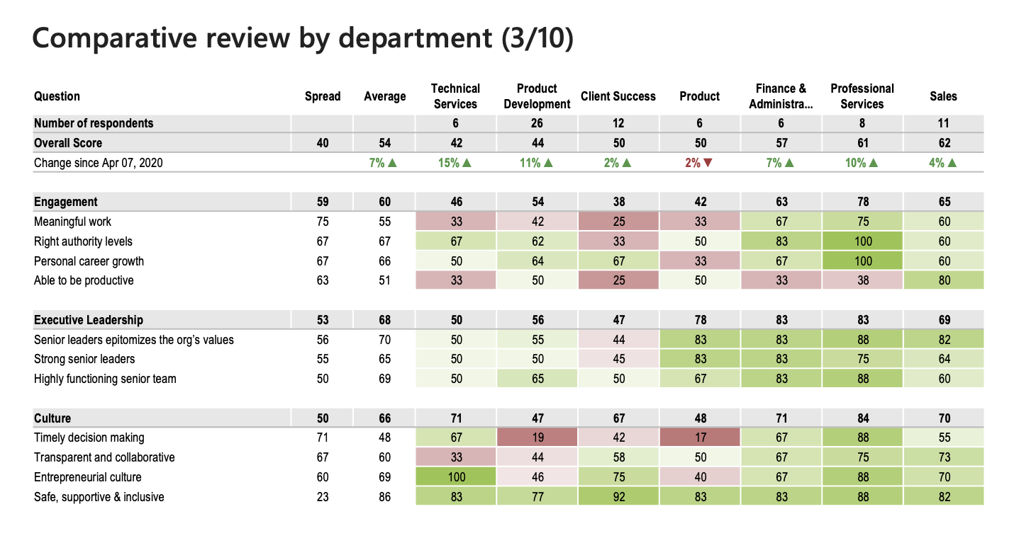
UNDERSTANDING YOUR ENTROMY REPORT
Comparative Review
Comparative Review slides provide a side-by-side comparison of dimensions (groups) and fixed answer question scores. The numbers represent the percentage of people who agree or strongly agree with the questions asked.
These slides show you the areas of strength (i.e., 100% of Professional Services employees agree or strongly agree that they see personal career growth) as well as areas of opportunity (only 25% of Client Success employees agree or strongly agree that their work is meaningful).

Slide 11
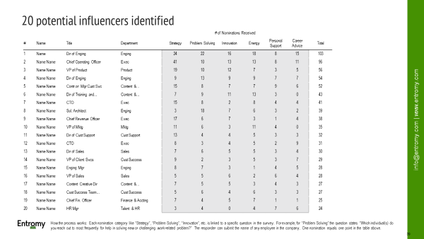
UNDERSTANDING YOUR ENTROMY REPORT
Influencers
The purpose of this slide is to provide your company with a list of people who have a substantial amount of influence within the organization. Based action items determined as a result of the survey data, this list will serve as people at the company who can be tapped and utilized to drive your change forward.
How the process works: Each nomination category like “Strategy”, “Problem Solving”, “Innovation”, etc. is linked to a specific question in the survey. For example, for “Problem Solving” the question states “Which individual(s) do you reach out to most frequently for help in solving new or challenging work-related problem?” The responder can submit the name of any employee in the company.
One nomination equals one point in the table above.

Slide 12
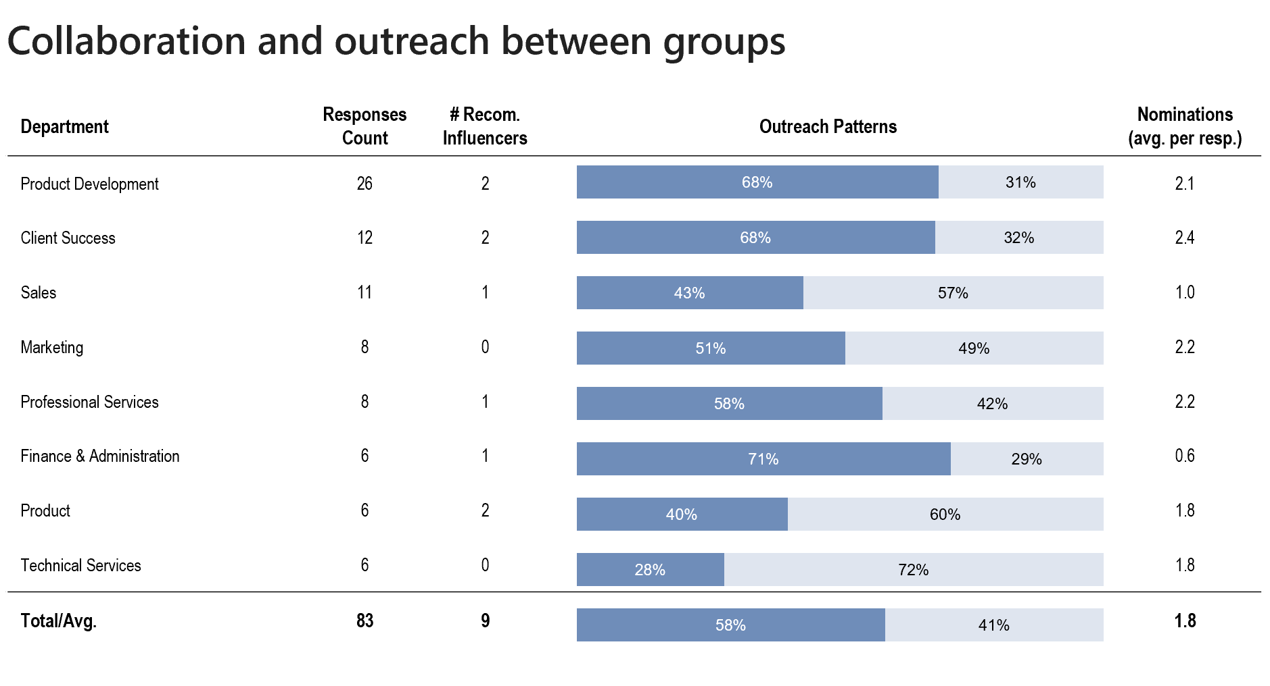
UNDERSTANDING YOUR ENTROMY REPORT
Collaboration and Outreach Between Groups
Number of recommended influencers: # of people in the department who were nominated as influencers. Recommended influencers are a subset of individuals that provide the broadest coverage of the organization. Entromy filters out redundant people from the list (i.e., those with overlapping spheres of influence)
Outreach patterns:
In group: % of nominations in a department (i.e., sales) that are for people within the same department (i.e., sales)
Other group: % of nominations in a department (i.e., sales) that are for people outside of that department (i.e., finance, product, marketing)
External: % of nominations in a department (i.e., sales) that are people outside of the organization or participant list. Entromy platform allows for write-in nominations.
Nomination per average responder:
For Marketing, everyone who responded to the survey, nominated 2.2 number of people on average

Slide 13
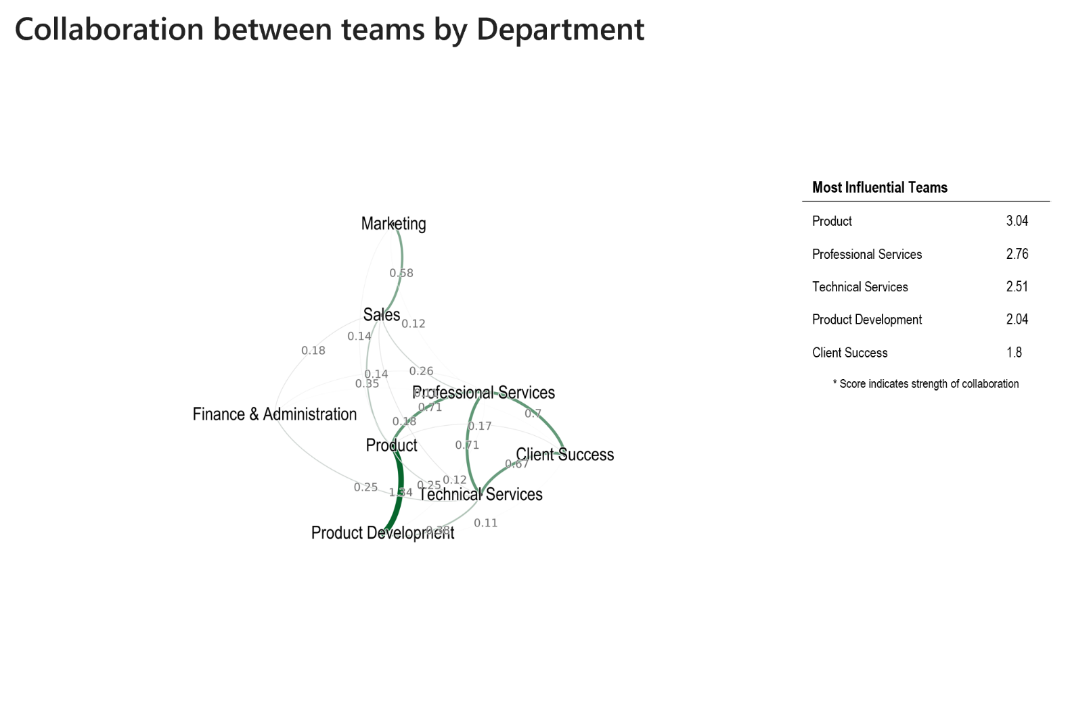
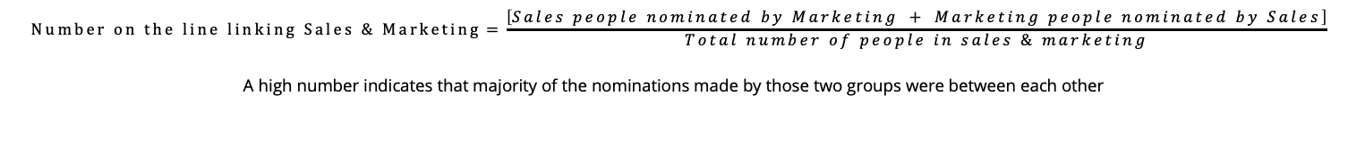
UNDERSTANDING YOUR ENTROMY REPORT
Collaboration between Teams by Department
A visual representation of the level of closeness and collaboration within the organization. This output is generated from the questions in the Collaboration section. Each dot represents a department (in the collaboration by dept chart). The line weight connecting two departments shows the strength of collaboration between teams.
Most Influential Teams Table: Sum of all the numbers on the lines
Each organization is unique, so the numbers can vary significantly between organizations. What’s important to note is the relative ranking of the departments on this table. The departments at the top are the ones that are highly collaborative compared to others.
Much like the other slides in the ONA section, it’s important to approach the results with a hypothesis in mind. Questions to ask yourself: What department did you expect to see in the center? If there was a merger, do you notice any silos? Are there groups that are disconnected from others? Which teams should be working closer together but are not connected?
$$Number on the line linking Sales \& Marketing=\frac{\left[Sales people nominated by Marketing + Marketing people nominated by Sales\right]}{Total number of people in sales \& marketing}$$
A high number indicates that majority of the nominations made by those two groups were between each other

Slide 14
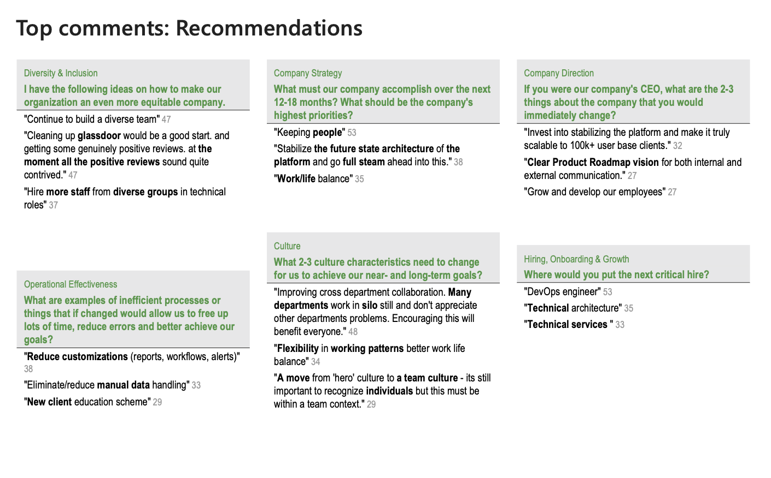
UNDERSTANDING YOUR ENTROMY REPORT
Top Comments
Top comments slides show responses to open-ended survey questions. Next to each comment is a score, representing the level of agreement that a particular response has gained throughout the survey itself. Participants are encouraged to react to their colleagues' responses and based on the the level of endorsements, the result is a numeric point value.
For each unique response, the comment is assigned 5 points. For each positive endorsement, the comment gains 3 points. For each negative endorsement, the comment loses 3 points.
More important than actual point value is the relative order of the comment.

Slide 15
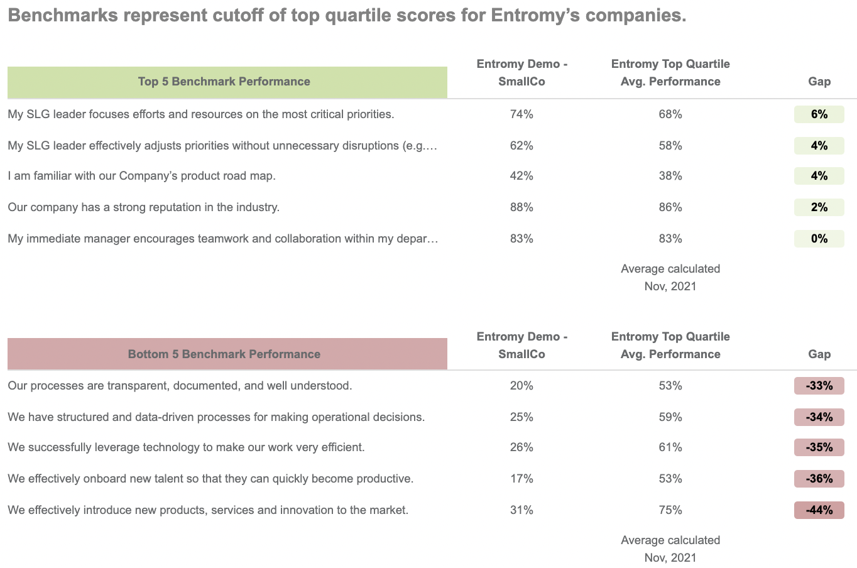
UNDERSTANDING YOUR ENTROMY REPORT
Benchmark Scores
The top five and bottom five benchmark scores as they compare to Entromy’s top performing companies.
The column titled “Entromy Top Quartile Avg. Performance” shows data for other companies that have run surveys with Entromy and score in the top 25% of organizations across several industries, sizes, sectors, etc.

Slide 16
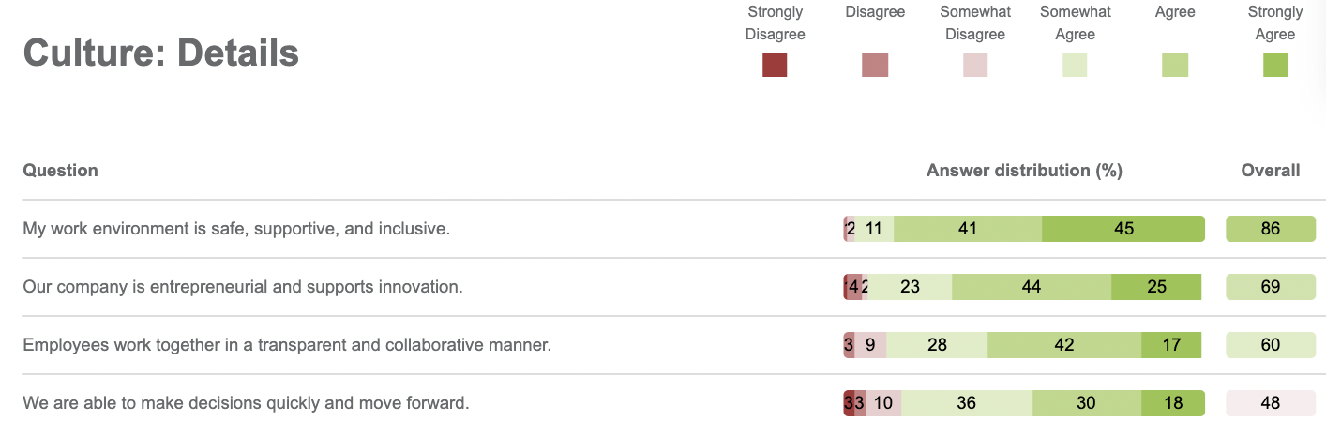
UNDERSTANDING YOUR ENTROMY REPORT
Score Details
Score Details slides show the percent answer distribution for each fixed answer (6-point Likert scale) question.
The right column titled “Overall” shows the overall percentage of respondents who rated agree or strongly agree for a question.
This slide provides the opportunity to focus on questions with lower scores and see in what cases participants have selected options other than strongly agree/agree and in what percentage.

Slide 17
Action Planning With Your Team
Highlight focus areas
Call attention to the focus areas from your scores and explain why they could be selected as top priorities.
Don’t bite off more than you can chew
If you more than 2 – 3 focus areas, it will be difficult to concentrate your efforts and make an impact. It’s far better to select only the top priorities and make significant strides than to select several focus areas and make limited progress. After you have reached your goals on the top priorities, you can work on additional areas.
Involve employees
Employee commitment and involvement is a key ingredient for successful organizational change. People are much more likely to support solutions that they played a part in creating. Be sure to involve your team in choosing the items that will be action planning priorities. Refer to this action planning guide for guidance and best-practices when it comes to leading successful action planning with your teams.
Importance
For each area of focus selected you can answer these two questions: “Why is it important for us to work on this area? and “What benefits will we derive?”
Actionable
Be sure the areas you select for focus are directly actionable, i.e., within the power of your team to change. For example, although the survey results may show that many employees are not satisfied with their pay, there may be little to nothing you can do about it. This would not be a good focus area.
In contrast, if the survey results show that many employees feel that they are not receiving enough feedback from their supervisors, the team can take several different actions to remedy the situation.
Focus the teams
It’s usually most effective to form teams that focus on just one of the areas that you have identified for strengthening. Thus, if you have chosen two areas to work on, you could form two teams; if you chose three areas, you could form three teams.

